Slide 1
Erasmus+, Key Action 2: Strategic partnership PROJECT NUMBER: 2015-1-FR01-KA203-015261 IO1: Open Online Courses on Social Entrepreneurship Learning Material Age Management and Diversity Management

Slide 2
AGE MANAGEMENT
- Concepts and Goals. Reasons for inclusion in strategies.
Dimensions.
Conclusions and Recommendations.
DIVERSITY MANAGEMENT
- Concepts and ambits.
Advantages and drawbacks.
Proposal for a diversity management model.

Slide 3
AGE MANAGEMENT
New Management Area: AGE vs Professional Careers and Profiles
Getting proper balance and generational change in organizations.
GOAL: Build a culture that adapts to, normalizes and tolerates age difference and ageing in the workplace.
Companies maintain competitiveness in demographic decline environments.
Retain more experienced workers (Know-How) closer to retirement.
(+) Generate more effective labor and commitment of workers.
(-) Growth of intergenerational conflict and inequality.

Slide 4
AGE MANAGEMENT
Figure1: Functional ability of male worker vs. age (careless life vs. individual Age Management)
Source: Data and Work Ability Assessments were based on the Work Ability Index developed by Tuomi et al (1998)

Slide 5
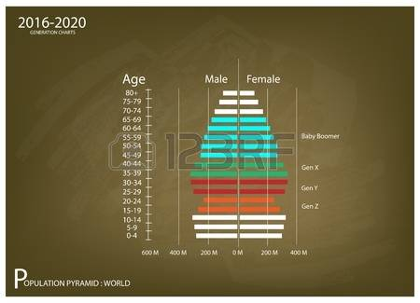
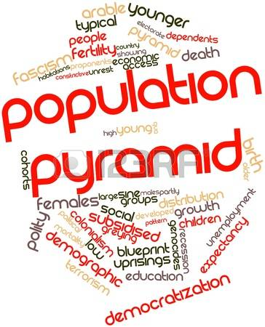
AGE MANAGEMENT
Reasons for development
Ageing population
New technologies

Slide 6
AGE MANAGEMENT: Dimensions involved
Employment Life Cycle Analysis ➔ Range of Experiences and Skills:
Work on self-knowledge, confidence and self-motivation with regard to the labor market.
Increasing resilience and developing professional competences.
Creating personal brand (drafting letters, writing a curriculum, preparing and training for possible job interviews, and so on).
Ongoing training, motivation and job-specific training.
Application of principles of project and time management.
Professional recycling and integration of new technologies.

Slide 7
AGE MANAGEMENT: Key Areas
Working Life Cycle Analysis:
Active and productive Recruitment
Allen Blue, Linkedin CEO: https://www.youtube.com/watch?v=tOLZ5TI-sHY
3 choices when devising its Human Resources policy between:
* Optimizing current workforce through training or recycling programs instead of contracting new personnel;
* Enlarging the workforce, improving its job suitability and improving the quality of the existing workforce by bringing together new and experienced professionals; or
* Cutting back the existing workforce, with all the social, human and economic costs that involves.

Slide 8
AGE MANAGEMENT: Key Areas
Working Life Cycle Analysis:
Management of Learning and knowledge.
https://www.youtube.com/watch?v=sBVu9oZa4gI
The transformation of knowledge happens in the following four stages:
Socialization (tacit-tacit knowledge): individuals acquire new knowledge directly from others.
Externalization (tacit-explicit knowledge): knowledge is articulated tangibly, through dialogue, and fleshed out in schemes, formulas and methods.
Combination (explicit-tacit knowledge): different forms of explicit knowledge are combined with the aid of documents or databases.
Internalization (explicit-tacit knowledge): individuals internalize documentary knowledge in their own experience.

Slide 9
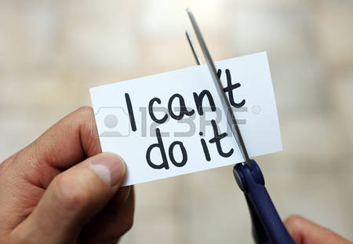
AGE MANAGEMENT: Key Areas
Working Life Cycle Analysis:
Attitude change and flexible work practices.
Example: Outdoor training experience. This could bring about genuine attitude change and build awareness about team work and the company’s values and vision.
https://www.youtube.com/watch?v=6MBM9wTkfoY

Slide 10
AGE MANAGEMENT: Key Areas
Working Life Cycle Analysis:
Health Management.
Can impact competitiveness and absenteeism.
The satisfaction of work well done, opportunities for personal development and the worker’s capacity to take part in decision making are factors which can impact the smooth running of a company and lead to the early departure of experienced workers on account of what is known as the “psychological contract”, which affects both body and mind.
Example: Provision of medical check-ups for workers.

Slide 11
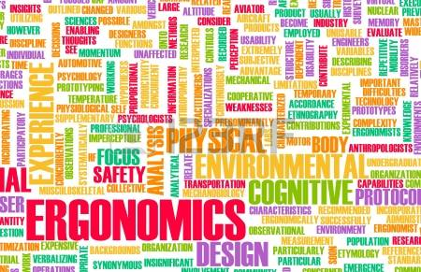
AGE MANAGEMENT: Key Areas
Working Life Cycle Analysis:
Working environment and ergonomics.
Incentives to retain more experienced workers
Integration of new technologies

Slide 12
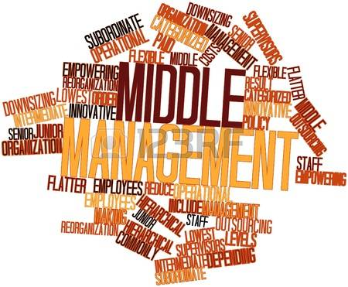
AGE MANAGEMENT: Conclusions
Working Life Cycle Analysis by a comprehensive corporate business policy
“Encore Careers”
“Golden workers”
“Silver Economy”
GLOBAL STRATEGIC APPROACH vs INDIVIDUAL.

Slide 13
DIVERSITY MANAGEMENT
Complex growth of an organization through authenticity actions.
3 AREAS:
Individual, within a company.
Group, affecting the whole or group of individuals (departments, teams, etc.) within the organization.
Institutional, global organization facing the inside and outside.

Slide 14
DIVERSITY MANAGEMENT: AMBITS
Strategic:
- Differents Knowlegde levels, cultural background, age, sex, etc.
- Workforce diversification to meet different challenges of market.
Operational:
- Appropiate behavior in foreign business environments.
- Intercultural business relationships.

Slide 15
DIVERSITY MANAGEMENT:
In practice, Diversity Management affect the following aspects of organizations:
Collection (statistical) data through surveys.
Diversity or culture Audit.
Based on the information gathered, a strategy of diversity management is formed.
Also affects recruitment, training, promotion, performance ratings and payment policies.

Slide 16
DIVERSITY MANAGEMENT
ADVANTAGES:
Flexibility and Adaptability.
Different opinions (Problems can be approached from different viewpoints).
Encouraging creativity (Development of other people's ideas).
Friendliness of customers due to offering services better adapted.
Retaining talent.
Continuous and mutual learning.
DRAWBACKS:
Potentially high costs in terms of money and time.
Conflicts and potential misunderstandings.

Slide 17
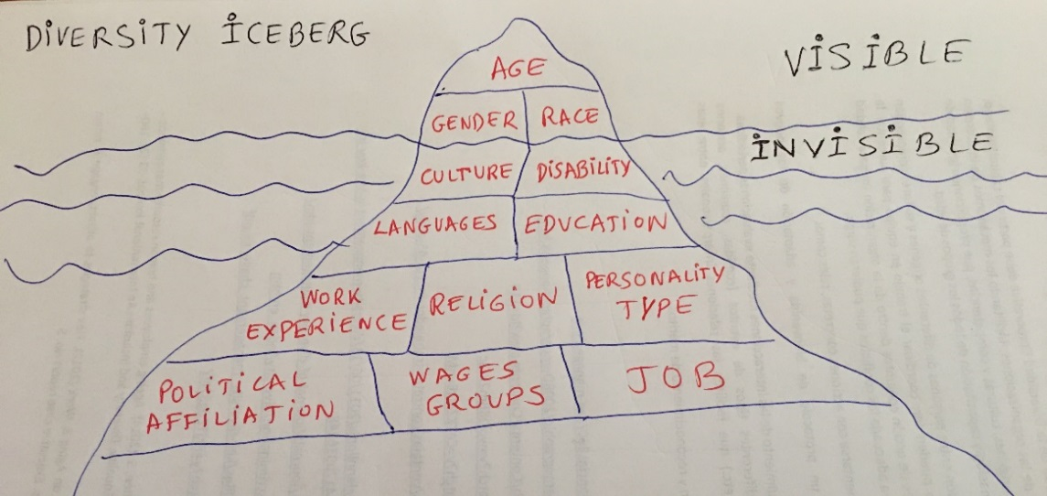
DIVERSITY MANAGEMENT
Proposal for a model of diversity management:
MBI Model by DiStefano and Maznevski (2003).
MAPPING (Differences in organization).
BRIDGING (Effective communication between individuals).
INTEGRATING (Manage the differences by identifying existing synergies and encouraging participation).

Slide 18
DIVERSITY MANAGEMENT
Goals of mechanisms of interaction between people of different origins and cultures:
Coordinating teamwork to increase productivity;
Draw up joint action plans within the organization (improving quality of work) or
Giving appropriate treatment to conflicts which might arise.

Slide 19
DIVERSITY MANAGEMENT
These goals should be implemented with specific actions such as:
Drafting a welcome and adaptation protocol for new workers.
Monitoring interactions through periodical assessments.
Organizing different events /meals, get-togethers, training activities, parties, etc.) to foment interpersonal relations among employees, etc.
Setting up a retention and recognition of merits committee.

