Slide 1
Erasmus+, Key Action 2: Strategic partnership PROJECT NUMBER: 2015-1-FR01-KA203-015261 IO1: Open Online Courses on Social Entrepreneurship Learning Material Co-production, co-creation and cooperation

Slide 2
Index
Introduction
Fashion in the ENTREPRENEURSHIP
Creation of COMMUNITIES & NETWORKING
Differentation between co-CREATION, co-PRODUCTION &
co-OPERATION.

Slide 3
1. Introduction/ CONCEPTS
Co-creation: co-create itself, it is not registered, but if we are looking for this concepts separately; create: 1. Work wit, laborious art or craft, with a big inventiveness. The prefix co- gives us a clue to the social scope of this action and effect of creating.
Co-production: 1. Action co-produce. 2. Especially in film, television, music and theater, production realized in common between several companies, usually from different countries.
Cooperation: 1. Action and effect to cooperate. 2. On the corporate front, possibility of several companies to adopt a system of more intense integration in some areas or activities.

Slide 4
1. Introduction/ CONCEPTS
- Entrepreneur: it is somebody who, individually or collectively, is looking for the definitely Business Model, in the course of one until five years. Once he found and tested his working and performance, he will become in business man.
Scalable Startup
Transition
Company
The search for the Business Model
The execution of the Business Model
Cash flow breakeven
Profitable
Rapid scale
New Senior Management
More of 150 people
Business Model found
Product/ Market fit
Repeatable sales model
Managers hired
Figure 1: From Startup to the Company.
Adaptation of the original by Steve Blank.
Own source.

Slide 5
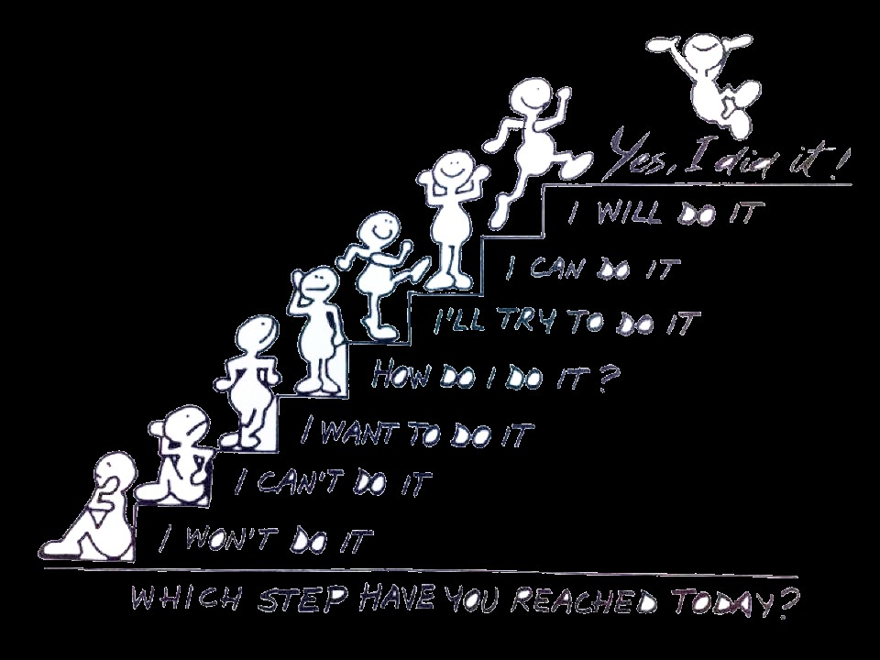
2. SOCIAL entrepreneurship
- When we have to start a Startup, or, otherwise, to execute an idea, the first thing we think on the need and that target of costumer we cover. Then, immediately, we look at the resources that we have to achieve and after, we try to answer with these resources to the creation to this product or service.
Figure 2: Step by Step.
Creative Commons Image.

Slide 6
Step 1: The three F (Friends, Family and Fools):
Ask money or resource at the people around, like this, they bet in your idea. Do it before that you ask for loans or investors. These people support you without expecting anything in return and the money arrive for realizing your first investment.

Slide 7
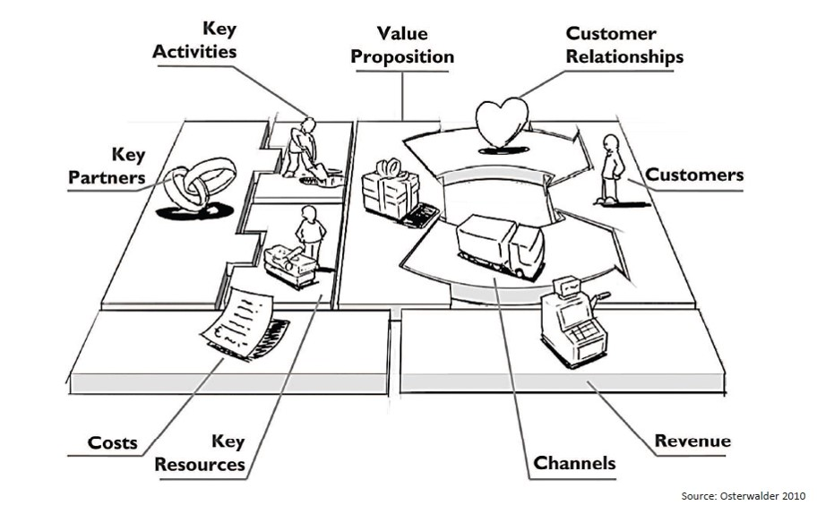
Step 2: Generate a Business Canvas Model (BCM):
To generate a Business Canvas Model is making to fit the puzzle pieces. This pieces will give us an overview of the objectives to be run, in the short and long term, how to receive income and expenses have during the execution of the idea.
Figure3: Business Canvas Model.
Osterwalder 2010.

Slide 8
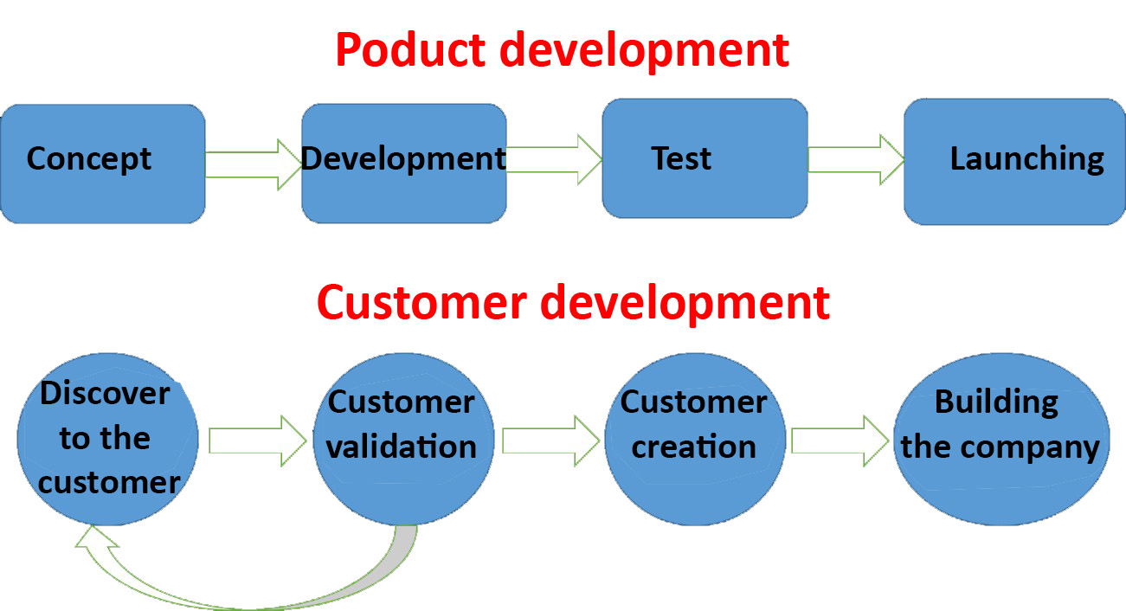
Step 3: Use the feedback:
We propose to subject this product or service to the customer development. So, we will use the feedback to the early adopters to reconfigure and to optimize our product or service. This will ripen our learnings, to validate and to pivot toward the definitive Business Model.
TO PIVOT is a consequence of the LEARNINGS from your business, not just the product.
Figure 4: Customer development.
Adaptation of the original by Steve Blank.
Own source.
TO PIVOT
SELL STOPS AND LISTEN TO YOUR CUSTOMERS. VALIDATE YOUR LEARNINGS!!!

Slide 9
Step 4: Study the market:
Identify the competitors and study like she has moved in order to become company. That is, what is her added value? Also, we will study the substitutive products or services of our added value.
When we identify the competitors, we have to ask us self: Could it be, using the prefix co-, our COOPETITORS? Could we collaborate, co-create, cooperate, and, coproduce?
Figure 10: Networking.
Creative Commons Image.

Slide 10
2.2. Concepts of SOCIAL ENTREP.
Non-profit entrepreneurship. Ex.: ONG
Cluster or place where several entrepreneurs stay to stablish human relationships that make them achieve, through their circle of incluence, better results.
Entrepreneurship developed to solve a need of society.
Entrepreneurship, that as a side effect, creates social benefits in society

Slide 11
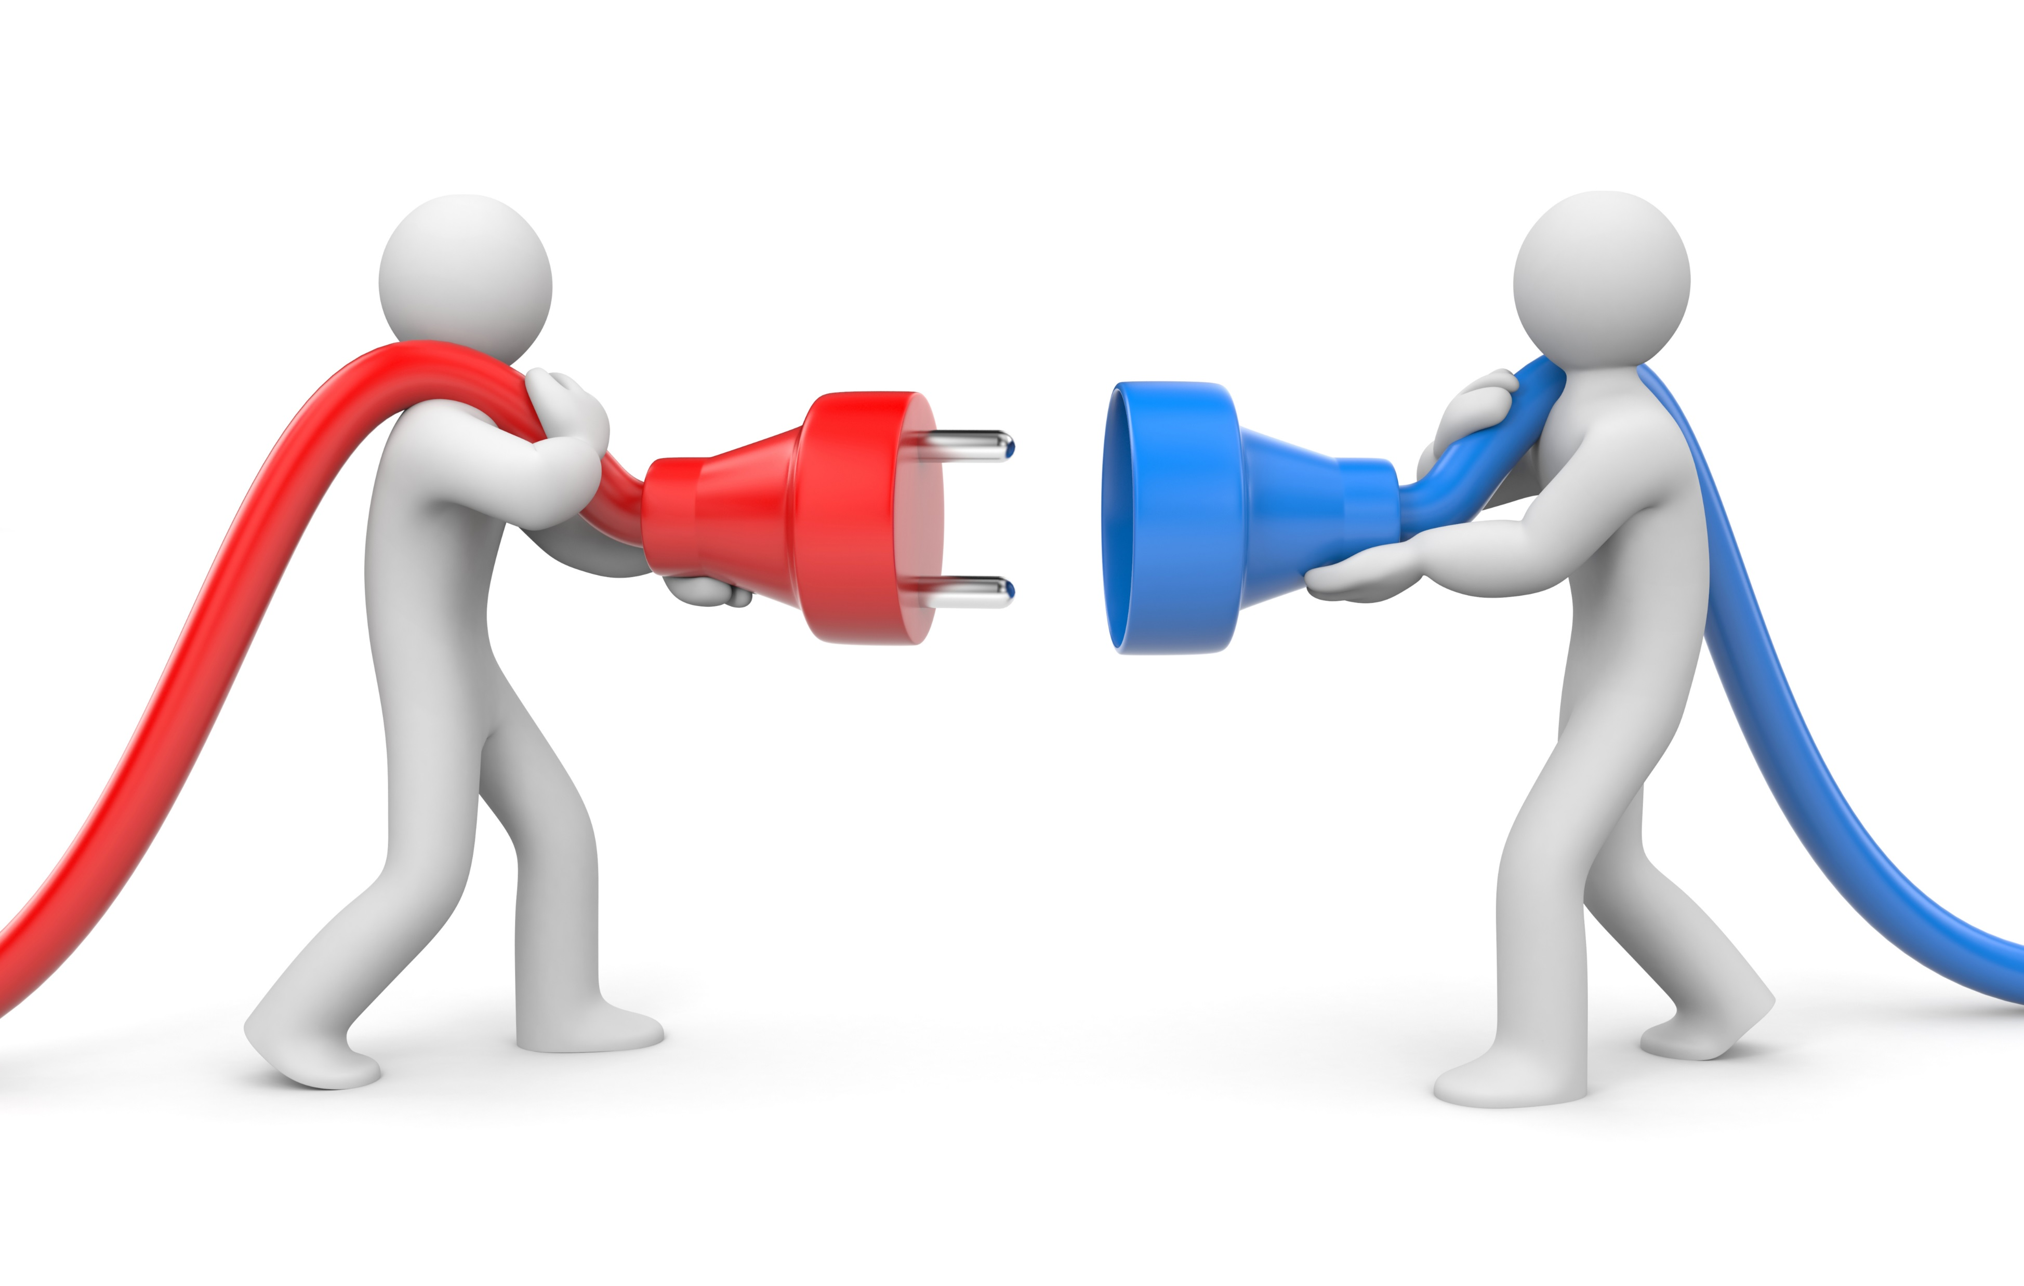
3. COMMUNITIES & NETWORKING
Coopetitiveness: it is the opportunistic collaboration between different economic actors who are also competitors. The term coopetition is a mixture or a merger between two words, competition and cooperation; it is a word fusion, or a generated neologism which is generated joining the start of a word to the other word.
Figure 11: Coopetitors.
Creative Commons Image.

Slide 12
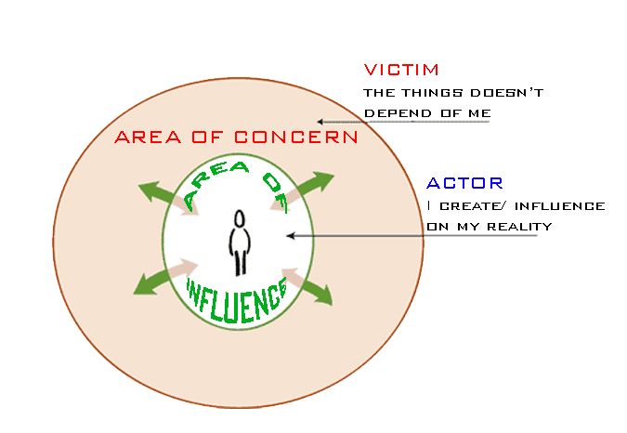
Someone might think: this is impossible, It cannot do it, the crisis, the lack of jobs, I have not this resource, etc. If someone is not a victim, and he takes a control of his own situation, he will begin to move his influence circle. I have not this resource, but I know who has it. I call him, we achieve convergence points to stablish a negotiation, I help you and you help me.
Figure 12: Influence circle.
Adaptation of Stephen Covey.
Own Source.

Slide 13
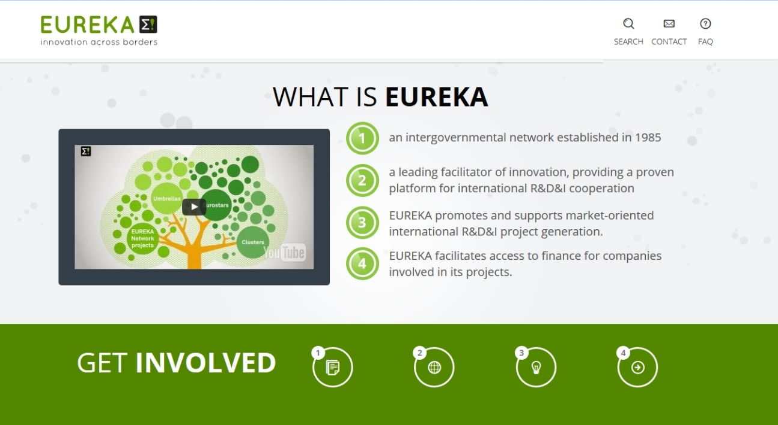
A) Case of study 1.
Platform like: industrial districts, associations, conferences, science and technology parks, incubators, business accelerators, coworking spaces.
BASED ON:
Trust relationschip
These spaces make easy to access to several services and supports
Powerful channels of communication to transmit the sector needs
Several proffesionals and sectors on the same place.
Example: EUREKA PLATFORM
From CDTI and EUROPA.
It is a search point between projects and entrepreneurs and companies.
Figure 13: EUREKA ® web.
www.eurekanetwork.org

Slide 14
B) Case of study 2.
Here we can talk about companies that look for cooperating to solve social problems. These can be: inequality, pollution, … and at the same time, they look for generating own and public benefits.
Example: ASHOKA
to promote social change through innovation and social entrepreneurship.
Figure 14: ASHOKA ® web.
http://spain.ashoka.org/

Slide 15
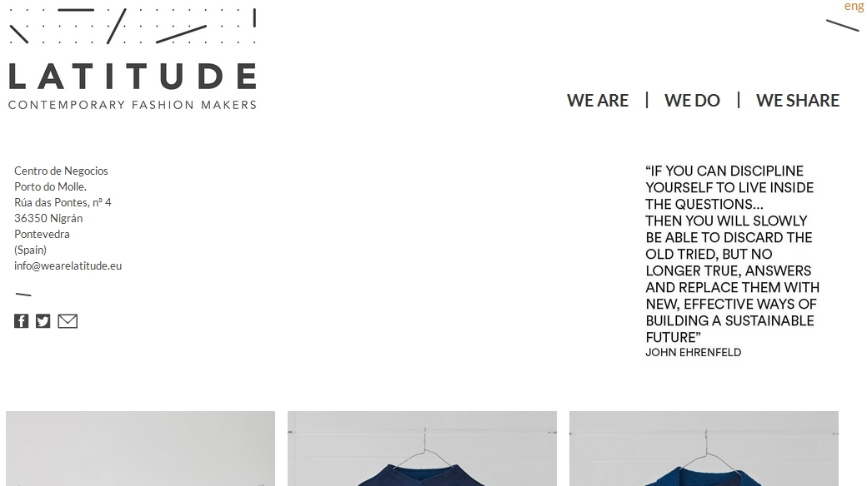
C) Case of study 3.
Also, example of some Company that belogns to this plaform is the Company LATITUDE. María Almazán is her CEO. This Company is focused on promoting on the fashion industry the sustainability of textile production. Then, the cusomers who consume these wears, they create a social benefit and a profit to the company. The company co-create with the customer.
Example: LATITUDE COMPANY.
Figure 18: LATITUDE Company web.
www.wearelatitude.eu

Slide 16
4. Differentations between CONCEPTS:
I) Co-creation is joint to create partnership between two or more startups or companies. We understand this because co-creating is to belong to the same group and focus on creating product or service from a single company or Startup. Therefore, the Project will be divided into shares of the company.
II) Co-production can be included from the point of view of supply chain management of a company.
III) Cooperation or collaboration, is the most given in the Startups, nowadays. It is a way to accelerate to put the product or service in the market. Between the resources of the Startup and Partners achieve to put the added value in the market as soon is possible. Like this, they quickly obtain the feedback and they make decision in consequence. The last thing is strongly joint to the concept of move your influence circle, to create the business network and to generate the called “favors chain”

Slide 17
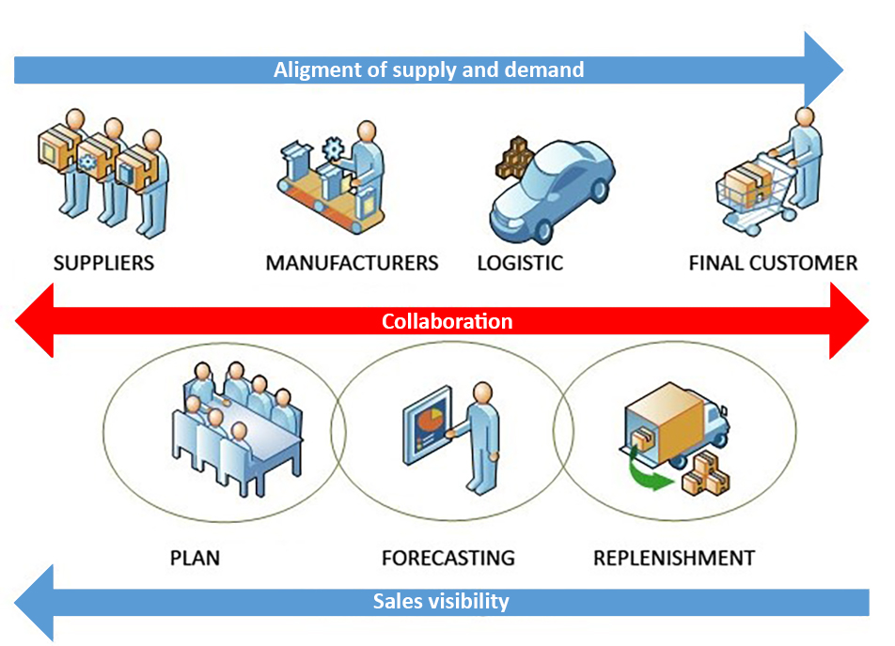
4.1. business applications: CPFR
One of the major applications of these concepts is the Business method of: Collaborative Planning Forecasting Replenishment (CPFR). It consists to use, of a synchronized way and effective, collaboration and co-production between business. An example of this is the talked about H&M.
Figure 15: CPFR.
Desarrollo conceptual de la logística.
By Bryan A. Salazar

